Slide 2
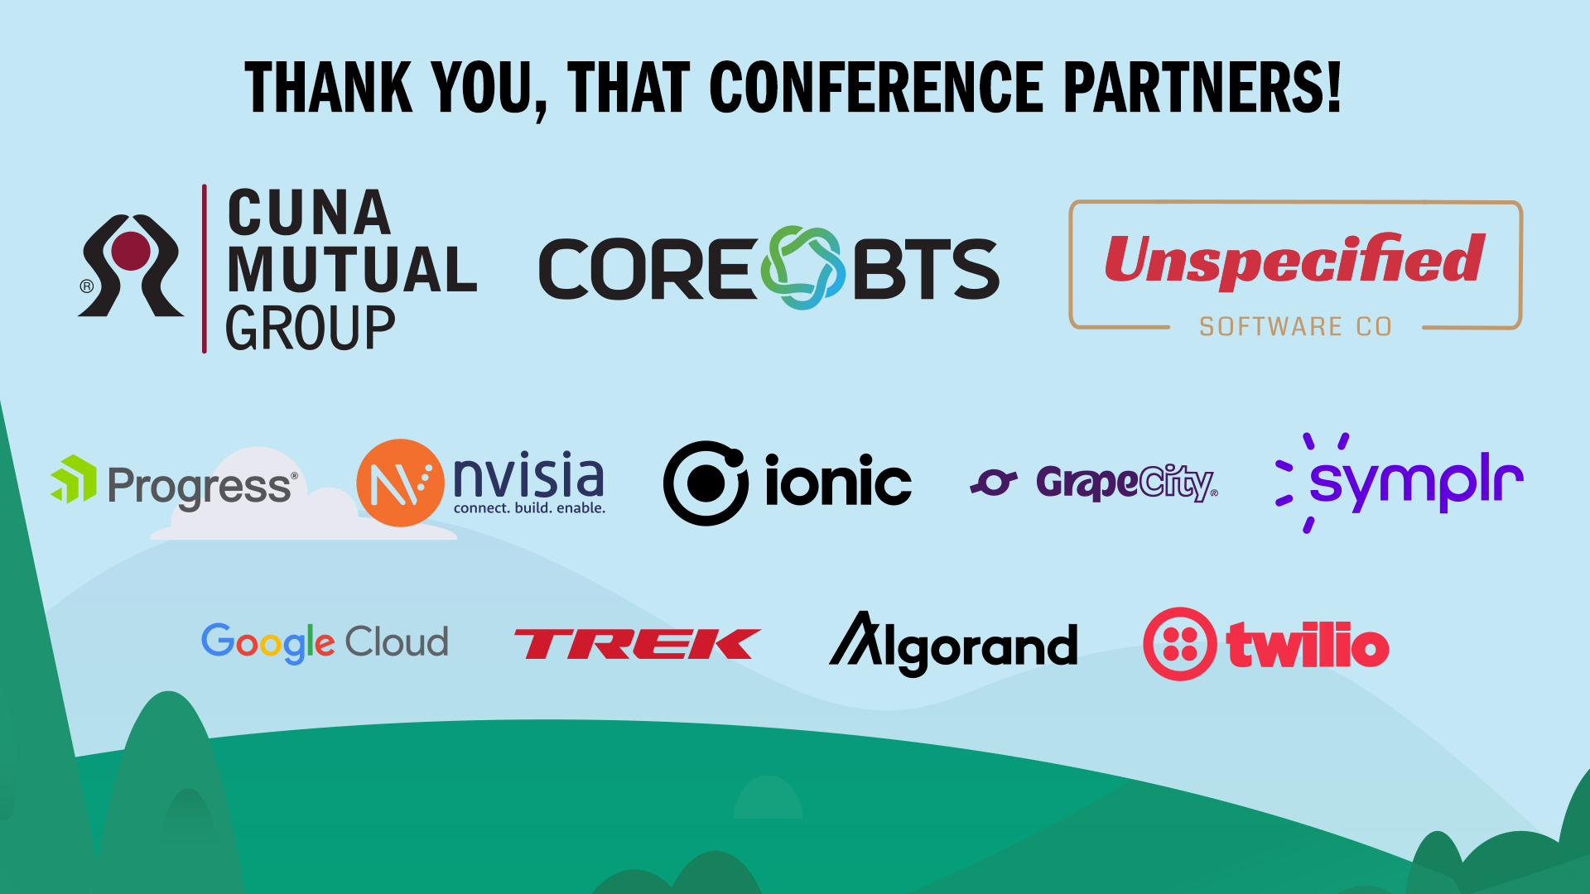

Slide 3


Slide 4


Slide 5







Who is Chad Green
chadgreen@chadgreen.com
TaleLearnCode
ChadGreen.com
ChadGreen & TaleLearnCode
ChadwickEGreen

Slide 6




August 17 – 19, 2022
Keynote – Christina Aldan
.NET Rocks! 20th Anniversary Party
A Toast to Women in Technology

Slide 7
How did I get started with NoSQL databases?

Slide 8
What are Relational Databases

Slide 9

Relational Model
First-order predicate logic
Described by Edgar Codd in 1969
Data represented in terms of tuples
Purpose is to provide declarative method for specifying data and queries
Notes:
Approach to managing data using a structure and language consistent with first-order predicate logic
First described by Edgard F. Codd in 1969
Where all data is represented in terms of tuples, grouped into relations
Finite ordered list (sequence) of elements
Purpose of relational model is to provide a declarative method for specifying data and queries: users directly state what information the database contains and what information they want from it, and let the database management system software take care of describing data structures for storing the data and retrieval products for answering queries

Slide 10
Codd’s 12 Rules
0: Foundation Rule
Notes:
October 1985
Rule 0: The Foundation Rule
For any system that is advertised as, or claim to be, a relational data base management system, that system must be able to manage databases entirely through its relational capabilities

Slide 11
Codd’s 12 Rules
0: Foundation Rule
1: Information Rule
Notes:
Rule 1: The Information Rule
The data stored in a database, may it be user data or metadata, must be a value of some table cell. Everything in a database must be stored in a table format.
All information in a relational database is represented explicitly at the logical label and in exactly one way – by values in tables.

Slide 12
Codd’s 12 Rules
0: Foundation Rule
1: Information Rule
2: Guaranteed Access
Notes:
Rule 2: The guaranteed access rule
Every single data element (value) is guaranteed to be accessible logically with a combination of table-name, primary-key (row value), and attribute-name (column value). No other means, such as pointers, can be used to access data.
Each and every datum (atomic value) in a relational database is guaranteed to be logically accessible by restoring to a combination of table name, primary key value, and column name.

Slide 13
Codd’s 12 Rules
0: Foundation Rule
1: Information Rule
2: Guaranteed Access
3: Systematic treatment of NULL values
Notes:
Rule 3: Systematic treatment of null values
The NULL values in a database must be given a systematic and uniform treatment. This is a very important rule because a NULL can be interpreted as one the following − data is missing, data is not known, or data is not applicable.
Null values (distinct from the empty character string or a string of blank characters and distinct from zero or any other number) are supported in fully relational DBMS for representing missing information and inapplicable information in a systematic way, independent of data type.

Slide 14
Codd’s 12 Rules
0: Foundation Rule
1: Information Rule
2: Guaranteed Access
3: Systematic treatment of NULL values
4: Active Online Catalog
Notes:
Rule 4: Dynamic online catalog based on the relational model
The structure description of the entire database must be stored in an online catalog, known as data dictionary, which can be accessed by authorized users. Users can use the same query language to access the catalog which they use to access the database itself.
The database description is represented at the logical level in the same way as ordinary data, so that authorized users can apply the same relational language to its interrogation as they apply to the regular data

Slide 15
Codd’s 12 Rules
0: Foundation Rule
1: Information Rule
2: Guaranteed Access
3: Systematic treatment of NULL values
4: Active Online Catalog
5: Comprehensive data sublanguage
Notes:
Rule 5: The comprehensive data sublanguage rule
A database can only be accessed using a language having linear syntax that supports data definition, data manipulation, and transaction management operations. This language can be used directly or by means of some application. If the database allows access to data without any help of this language, then it is considered as a violation.
A relational system may support several languages and various modes of terminal use. However, there must be at least one language whose statements are expressible, per some well-defined syntax, as character strings and that is comprehensive, per some well-defined syntax, as character strings and that is comprehensive in support all of the following items:
Data definition
View definition
Data manipulation (interactive and by program)
Integrity constraints
Authorization
Transaction boundaries (begin, commit, and rollback

Slide 16
Codd’s 12 Rules
0: Foundation Rule
1: Information Rule
2: Guaranteed Access
3: Systematic treatment of NULL values
4: Active Online Catalog
5: Comprehensive data sublanguage
6: View Updating
Notes:
Rule 6: The view updating rule
All the views of a database, which can theoretically be updated, must also be updatable by the system.
All views that are theoretically updatable are also updatable by the system

Slide 17
Codd’s 12 Rules
0: Foundation Rule
1: Information Rule
2: Guaranteed Access
3: Systematic treatment of NULL values
4: Active Online Catalog
5: Comprehensive data sublanguage
6: View Updating
7: Possible for high-level insert, update, and delete
Notes:
Rule 7: Possible for high-level insert, update, and delete
A database must support high-level insertion, updation, and deletion. This must not be limited to a single row, that is, it must also support union, intersection and minus operations to yield sets of data records.
The capability of handling a base relation or a derived relation as a single operand applies not only to the retrieval of data but also the insertion, update, and deletion of data.

Slide 18
Codd’s 12 Rules
0: Foundation Rule
1: Information Rule
2: Guaranteed Access
3: Systematic treatment of NULL values
4: Active Online Catalog
5: Comprehensive data sublanguage
6: View Updating
7: Possible for high-level insert, update, and delete
8: Physical data independence
Notes:
Rule 8: Physical data independence
The data stored in a database must be independent of the applications that access the database. Any change in the physical structure of a database must not have any impact on how the data is being accessed by external applications.
Application programs and terminal activities remain logically unimpaired whenever any changes are made in either storage representations or access methods.

Slide 19
Codd’s 12 Rules
0: Foundation Rule
1: Information Rule
2: Guaranteed Access
3: Systematic treatment of NULL values
4: Active Online Catalog
5: Comprehensive data sublanguage
6: View Updating
7: Possible for high-level insert, update, and delete
8: Physical data independence
9: Logic data independence
Notes:
Rule 9: Logical data independence
The logical data in a database must be independent of its user’s view (application). Any change in logical data must not affect the applications using it. For example, if two tables are merged or one is split into two different tables, there should be no impact or change on the user application. This is one of the most difficult rule to apply.
Application programs and terminal activities remain logically unimpaired when information-preserving changes of any kind that theoretically permit unimpaired are made to the base tables.

Slide 20
Codd’s 12 Rules
0: Foundation Rule
1: Information Rule
2: Guaranteed Access
3: Systematic treatment of NULL values
4: Active Online Catalog
5: Comprehensive data sublanguage
6: View Updating
7: Possible for high-level insert, update, and delete
8: Physical data independence
9: Logic data independence
10: Integrity Independence
Notes:
Rule 10: Integrity independence
A database must be independent of the application that uses it. All its integrity constraints can be independently modified without the need of any change in the application. This rule makes a database independent of the front-end application and its interface.
Integrity constraints specific to a particular relational database must be definable in the relational data sublanguage and storable in the catalog, not in the application programs.

Slide 21
Codd’s 12 Rules
0: Foundation Rule
1: Information Rule
2: Guaranteed Access
3: Systematic treatment of NULL values
4: Active Online Catalog
5: Comprehensive data sublanguage
6: View Updating
7: Possible for high-level insert, update, and delete
8: Physical data independence
9: Logic data independence
10: Integrity Independence
11: Distribution Independence
Notes:
Rule 11: Distribution independence
The end-user must not be able to see that the data is distributed over various locations. Users should always get the impression that the data is located at one site only. This rule has been regarded as the foundation of distributed database systems.
The end-user must not be able to see that the data is distributed over various locations. Users should always get the impressions that the data is located at one site only.

Slide 22
Codd’s 12 Rules
0: Foundation Rule
1: Information Rule
2: Guaranteed Access
3: Systematic treatment of NULL values
4: Active Online Catalog
5: Comprehensive data sublanguage
6: View Updating
7: Possible for high-level insert, update, and delete
8: Physical data independence
9: Logic data independence
10: Integrity Independence
11: Distribution Independence
12: Nonsubversion Rule
Notes:
Rule 12: The nonsubversion rule
If a system has an interface that provides access to low-level records, then the interface must not be able to subvert the system and bypass security and integrity constraints.
The end-user must not be able to see that the data is distributed over various locations. Users should always get the impression that the data is located at one site only. This rule has been regarded as the foundation of distributed database systems.
If a relational system has a low-level (single-record-at-a-time) language, that low level cannot be used to subvert or bypass the integrity rules and constraints expressed in the higher level relational language (multiple-records-at-a-time).

Slide 23
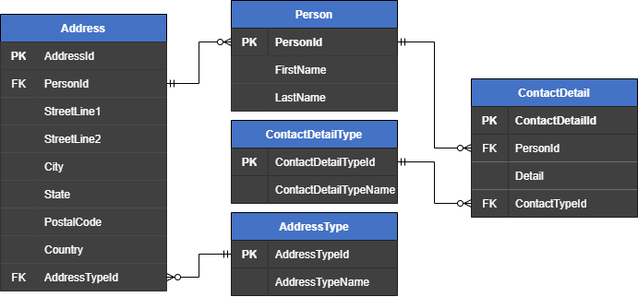
Typical Relational Model

Slide 24
True star of Relational Databases
SQL
Structured Query Language
SEQUEL
Notes:
Donald Chamberlin and Raymond Boyce with IBM started working on SEQUEL which was designed to manipulate and retrieve data stored in IBM’s System R (regarded as the first relational database system)
SEQUEL – Structured English Query Language
Introduced the concept of accessing many records with one single command and eliminated the need to specify how to reach a record with or without an index
First commercially available SQL was released in 1979 by Relational Software who had aspirations of selling it to the US Navy, CIA, and other government agencies; Relational ➔ Oracle
Officially adopted as a standard in 1986 and has had 11 versions (last version was 2019 – multidimensional array support)
SQL – San Carlos Airport

Slide 25

True star of Relational Databases
SQL
Structured Query Language
By Saufhn - Own work, CC BY-SA 4.0, https://commons.wikimedia.org/w/index.php?curid=87255205
Notes:
SQL – San Carlos Airport

Slide 26






Big Names in Relational Databases
Notes:
6 of top 10 according to db-engines.com
Oracle
MySQL
Microsoft SQL Server
PostgreSQL
MongoDB
Redis
IBM Db2
Elasticsearch
SQLite
Cassandra

Slide 27
What are NoSQL Databases

Slide 28
What are NoSQL Databases
Modeled in means other than tabular relations
Existed since late 1960s
Increasingly used in big data and real-time web applications
Notes:
Provide a mechanism for storage and retrieval of data that is modeled in means other than the tabular relations used in relational databases.
Such databases have existed since the late 1960s, but the name “NoSQL” in the early 2000’s, triggered by the needs of Web 2.0 companies
NoSQL databases are increasingly used in big data and real-time applications

Slide 29
NoSQL Motivations
Simplicity of Design
Simpler Horizontal Scaling
Finer Control over Availability
Limiting Object-Relational Impedance
Notes:
Simplicity of design
Simpler “horizontal” scaling to clusters of machines (scale out vs scale up)
Finer control over availability
Limiting the object-relational impedance mismatch
The data structures used by NoSQL databases are different from those typically used in relational databases, potentially making some operations faster.
Viewed as “more flexible”

Slide 30
Availability over Consistency
Relational
ACID Transactions
NoSQL
Eventual Consistency
Notes:
ACID (atomicity, consistency, isolation, durability) : intended to guarantee data validity despite errors, power failures, and other mishaps. For example, a transfer of funds from one bank account to another, even involving multiple changes such as debiting one account and crediting another can be completed in one transaction.
Eventual consistency – database changes are propagated to all nodes “eventually”; so queries for data might not return updated data immediately or might result in reading data that is not accurate (stale reads)

Slide 31
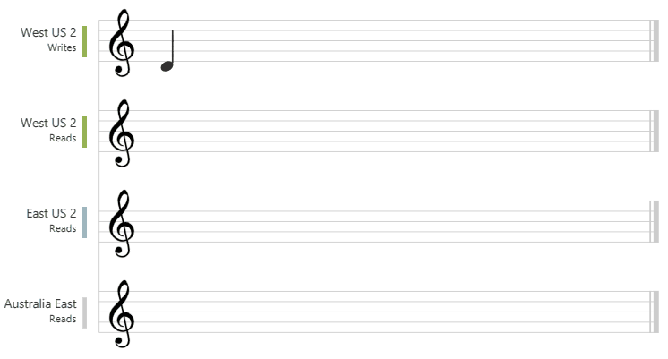
Eventual Consistency
Notes:
This graphic illustrates the eventual consistency with music notes

Slide 32
What’s in a Name
NoSQL

Slide 33
What’s in a Name
NoSQL

Slide 34
What’s in a Name
Not only SQL
Non-SQL
Non-Relational
NoSQL

Slide 35
What’s in a Name
Not only SQL
Non-SQL
Non-Relational
NoSQL

Slide 36
What’s in a Name
No-Schema
Not only SQL
Non-SQL
Non-Relational
NoSQL
Notes:
Next slide – Along with different names, there are a lot of different types of NoSQL databases

Slide 37





Many types of NoSQL databases
Document
Notes:
Document databases store all information for a given object in a single instance in the database instead of multiple objects like in a relational database

Slide 38
Typical Relational Model

Slide 39
Same but in a document database
{
"id": "1",
"firstName": "Thomas",
"lastName": "Andersen",
"addresses": [
{
"city": "Seattle",
"state": "WA",
"type": {
"name": "Primary"
}
}
],
"contactDetails": [
{
"detail": "First Detail",
"type": {
"name": "A detail type"
}
}
]
}

Slide 40
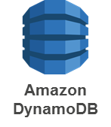


Many types of NoSQL databases
Key-Value
Notes:
Data storage paradigm designed for storing, retrieving, and managing associative arrays

Slide 41




Many types of NoSQL databases
Wide Column
Notes:
Uses tables, rows, and columns, but unlike a relational database, the names and format of the columns can vary from row to row in the same table
Can be interpreted as a two-dimensional key-value store

Slide 42
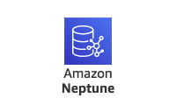


Many types of NoSQL databases
Graph
Notes:
Graph databases are designed for data whose relations are well represented as a graph consisting of elements connected by a finite number of relations.
Social media

Slide 43
Graph Databases

Slide 44
Many types of NoSQL databases
Document
Key-Value
Wide Column
Graph
Object
Tabular
Tuple Store
Triple Store
Notes:
Object Databases – Information is represented in the form of objects as used in object-oriented programming.
Tabular Databases – Database that is structured in a tabular form; arranges data elements in vertical columns and horizontal rows
Tuple Store – Based on tuple mathematics
Triple Store – Purpose-built database for storage and retrieval of triples through semantic queries. A triple is a data entity composed of subject-predicate-object like “Bob is 35” or “Bob knows Fred”

Slide 45
Picking a Data Store

Slide 46
Data Model Comparison
Data Model | Performance | Scalability | Flexibility | Complexity | Functionality
Key-Value Store | High | High | High | None | Variable (None)
Column Store | High | High | Moderate | Low | Minimal
Document Store | High | Variable (High) | High | Low | Variable (Low)
Graph | Variable | Variable | High | High | Graph Theory
Relational | Variable | Variable | Low | Moderate | Relational Algebra
Ben Scofield – NoSQL presentation at CodeMash 2010
Notes:
Ben Scofield – NoSQL presentation at CodeMash 2010

Slide 47
Things to think about
Skillset
Time to Market
Known Data Structure
Scalability

Slide 48
Don’t forget
Hybrid

Slide 49
Example Explainer

Slide 50

Based on Real-World Project
Product & Pricing Management (PPM)

Slide 51
Vacation Rental Listing
Allow property owners to list their vacation rentals
Allow vacationers the ability to search for vacation rentals
Provide vacationers with details of the properties
Allow for configurable property/room attributes
Localized versions of all the information

Slide 52
Data Model
User Accounts
Attributes
Properties
Reference Types
Content
Rooms

Slide 53
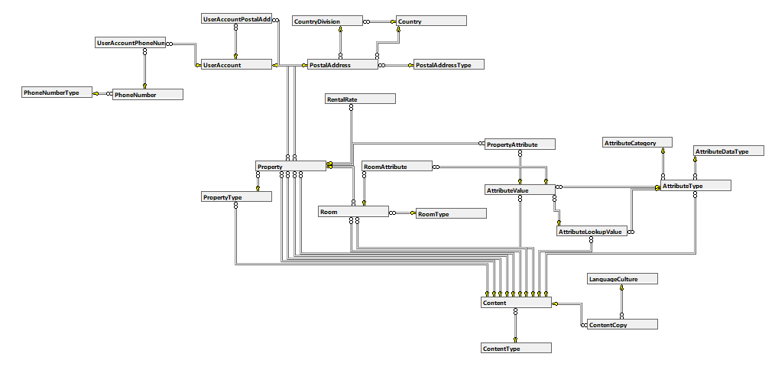
Relational Data Model

Slide 54
Real World: Why Relational
Skillset
Time to Market
Other Products

Slide 55
Issues Found in Real-World Project
Searching against the attributes is difficult
Navigation is deep

Slide 56
Very Quick Into to Cosmos DB

Slide 57





Azure Cosmos DB
Core (SQL) API
Table API
MongoDB
Column-family
Document
Key-value
Graph
Guaranteed low latency at the 99th percentile
Elastic scale out
of storage & throughput
Five well-defined consistency models
Turnkey global distribution
Comprehensive SLAs
Notes:
Turnkey global distribution
Elastic scale out of storage & throughput
Guaranteed low latency at the 99th percentile
Five well-defined consistency models
Comprehensive SLAs
The right data model for you use
Different Cosmos APIs to meet your needs

Slide 58
Which Azure Cosmos DB Data API?
Core (SQL) API
Core (SQL) API

Slide 59
Which Azure Cosmos DB Data API?
Core (SQL) API
MongoDB

Slide 60

Which Azure Cosmos DB Data API?
Core (SQL) API
Table Storage

Slide 61

Which Azure Cosmos DB Data API?
Core (SQL) API
Gremlin

Slide 62
Which Azure Cosmos DB Data API?
Core (SQL) API
Cassandra

Slide 63
Migrating to NoSQL

Slide 64
Document Database Structure
Cosmos DB Account
Database
Database
Container
Container
Container
Container
Item
Item
Item
Item
Item
Item
Item
Item

Slide 65
Vacation Rentals Data Model
User Accounts
Attributes
Properties
Reference Types
Content
Rooms

Slide 66
Vacation Rentals Data Model
User Accounts
userAccountId
Attributes
Attributes
attributeTypeId
Properties
Reference Types
referenceTypeName
propertyId
Content
Content
Content
Rooms
Notes:
Containers and then Partition Keys

Slide 67
Vacation Rentals Data Model
User Accounts
userAccountId
Attributes
Attributes
Reference Types
attributeTypeId
Properties
referenceTypeName
propertyId
Properties by Location
locationId
Notes:
Containers and then Partition Keys

Slide 68
User Account Migration
User Account
Property
UserAccount PhoneNumber
UserAccount PostalAddress
PhoneNumber
PostalAddress
PhoneNumber Type
PostalAddress Type
Country
CountryDivision

Slide 69
User Account Migration
User Account
Property
UserAccount PhoneNumber
UserAccount PostalAddress
PhoneNumber
PostalAddress
PhoneNumber Type
PostalAddress Type
Country
CountryDivision

Slide 70
User Account Migration
User Account
Property
PhoneNumber
PostalAddress

Slide 71
User Account Migration
Property
User Account

Slide 72
Attribute Migration
Property
Property Attribute
Room Attribute
Room
Attribute Value
Attribute Type
Attribute Data Type
Attribute Category
Attribute Lookup Value
Content
Language Content
Content Copy

Slide 73
Attribute Migration
Property
Property Attribute
Room Attribute
Room
Attribute Value
Attribute Type
Attribute Data Type
Attribute Category
Attribute Lookup Value
Content
Language Content
Content Copy

Slide 74
Attribute Migration
Property
Property Attribute
Room Attribute
Room
Attribute Value
Attribute Type
Attribute Data Type
Attribute Category
Attribute Lookup Value
Content
Content

Slide 75
Attribute Migration
Property
Property Attribute
Room Attribute
Room
Attribute Value
Attribute Type
Attribute Data Type
Attribute Category
Attribute Lookup Value

Slide 76
Attribute Migration
Property
Property Attribute
Room Attribute
Room
Attribute Value
Attribute Value
Attribute Value
Attribute Value
Attribute Type

Slide 77
Attribute Migration
Property
Room
Attribute Value
Attribute Value
Attribute Type

Slide 78
Property Migration
Property
Room Type
Rental Rate
Property Type
Postal Address Type
Room
Content
Property Type
Postal Address
Property Attribute
Room Attribute
Content Copy
Country
Attribute Type
Country Division
Attribute Data Type
Attribute Category
Attribute Lookup Value

Slide 79
Property Migration
Property
Room Type
Rental Rate
Property Type
Content
Content
Room
Content
Property Type
Postal Address
Content
Property Attribute
Room Attribute
Attribute Type
Attribute Type

Slide 80
Property Migration
Property
Room Type
Rental Rate
Property Type
Room
Content
Property Type
Postal Address
Property Attribute
Room Attribute

Slide 81
Property Migration
Property
Rental Rate
Property Type
Room
Content
Property Attribute
Postal Address

Slide 82
Property Migration
Property

Slide 83
Property Migration
Property

Slide 84
Reference Types
Country
Postal Address Type
Country Division
Property Type
Language/Culture
Room Type
Phone Number Type
Attribute Data Type
Attribute Category

Slide 85
Reference Types
Country
Postal Address Type
Country Division
Property Type
Language/Culture
Room Type
Phone Number Type
Attribute Data Type
Attribute Category

Slide 86

Reference Types
Postal Address Type
Postal Address Type
Postal Address Type

Slide 87
Best Tool(s) for the Job

Slide 88
Thank You
chadgreen@chadgreen.com
TaleLearnCode
ChadGreen.com
ChadGreen & TaleLearnCode
ChadwickEGreen

